Slide 2
Modeling the story of functions
Standards for Mathematical Practice
Common Core
Presenter: Ellen Falk
efalk@northsalemschools.org
www.mathizaverb.com
North Salem , NY

Slide 3
Mathematical Practice
From the Common Core Document under
Mathematics: Standards for Mathematical Practice p 5
4. Model with mathematics.
“Mathematically proficient students can apply the mathematics they know to solve problems arising in everyday life,
society, and the workplace. “

Slide 4
Context
“They routinely interpret their mathematical results in the context of the situation and reflect on whether the results make sense, possibly improving the model if it has not
served its purpose.”
From the Standards of Mathematical practice #4
Notes:
From the standards of mathematical practice #4 modeling

Slide 5
It’s Not Just About Content
Development of the pathways into instructional programs will require careful attention to modeling and the mathematical practices.
Assessments based on these pathways should reflect both the content and mathematical practices standards.”

Slide 6
Rules of Engagement
Loss of: Depth
Efficiency
Elegance
FOCUS
MATH IN CONTEXT
LOSS of :
Width,
Motivation, Applications
MATH WITH MATH

Slide 7
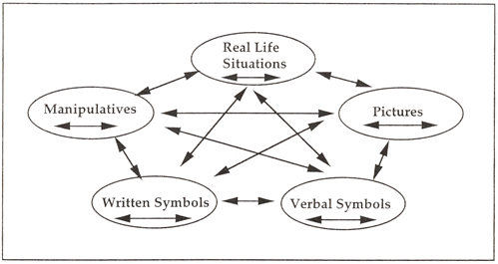
Representational Fluency
The Lesh translation model suggests that elementary mathematical ideas can be represented in five different modes: manipulatives, pictures, real-life contexts, verbal symbols, and written symbols. It emphasizes that translations within and between various modes of representation make ideas meaningful for students.

Slide 8
Performance Tasks
Designed to reveal a learner's understanding of a problem/task and her/his mathematical approach to it.
Can be a problem or a project, performance.
It can be an individual, group or class-wide exercise.

Slide 9
A good performance task usually has eight characteristics (outlined by Steve Leinwand and Grant Wiggins and printed in the NCTM Mathematics Assessment book).
Good tasks are: essential, authentic, rich, engaging, active, feasible, equitable and open.

Slide 10
Project Based Learning
Investigations and meaningful tasks.
Construct knowledge through inquiry.
Culminates in a realistic hands –on project.
5 Es Instructional Model.

Slide 11
Linear Model -Discrete
Cutting String
Simple, cheap! Use about 5 pieces of string per person
Domain, Range , independent variable, dependent variable, constant rate of change, arithmetic sequence, linear function, linear regression, modeling.
Notation- How you want students to communicate their mathematics.
Problem solving
How do we keep track of the data?
How do we look for relationships?

Slide 12
Cut the String- no cuts

Slide 13
1 cut

Slide 14
2 cuts

Slide 15
3 cuts

Slide 16
Number of cuts n | Pieces of String
0 | 1
1 | 3
2 | 5
3 | 7
4 | 9
2
2
2
2

Slide 17
How to communicate the model
And the function is….S(n)=2n +1,
Recursively speaking..
S₁ = S₀ +2
S₂ = S₁ +2
S₃ = S₂+2
S _{n+1}= S _{n} +2, S₀ =1

Slide 18
From Regents Prep
Is there an issue with the subscripts when following this formula compared to the work on the previous slide?

Slide 19
More Models
Linear
What’s Your Measure-continuous
Crickets-continuous
Quadratic
Leap Frog- wooden manipulaitve
NLVM Java applet ( Peg Puzzle)
Empire State-continuous
Exponential
Bust-A_Move ( NLVM java applet Tower of Hanoi)
The number “e”

Slide 20
LeAp FrOg
Create your data table.
Examine the common difference.
What do you notice? Pattern?
Take the common difference of the differences. What do you notice?

Slide 21
LeAp FrOg
Number of Pairs n | Number of Moves M
1 | 3
2 | 8
3 | 15
4 | 24
5 | 33
5
2
7
2
9
2
11
Quadratic!!! Recall Calculus?

Slide 22
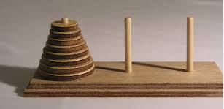
Tower Of Hanoi

Slide 23
Tower of Hanoi
Number of disks n | Number of Moves M
1 | 1
2 | 3
3 | 7
4 | 15
5 | 31
2
2
4
4
8
8
16
Exponential!!! Recall Calculus?

Slide 24
Summary Points
Start with discrete models.
Let them think! Let them LINK.
Free form modeling- let the student construct the solution in their own way then…
Formalize their communication.
Be positive problem solvers.

Slide 25
Summary Questions
What is meant by mathematical modeling?
How do we construct meaningful tasks?
Where do I start?
How many do we need?
Real, relevant, reliable, reusable.

Slide 26
Videos
Dan Meyer-math class needs a makeover.
RSA Animate-Ken Robinson
Hans Rosling : Population Growth over 200 years.
David McCandless turns complex data sets (like worldwide military spending, media buzz, into beautiful, simple diagrams that tease out unseen patterns and connections.
Taylor Mali- just because

Slide 27
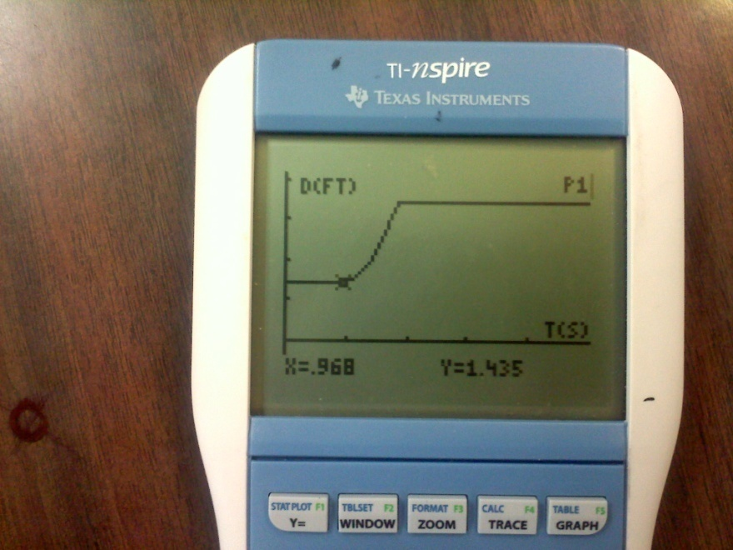
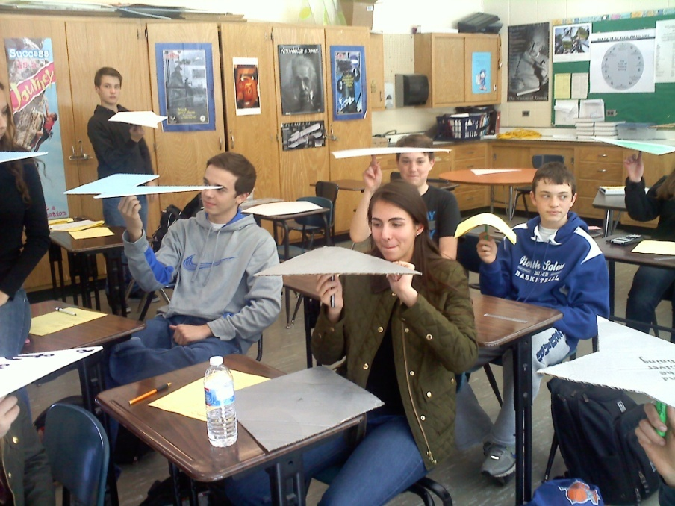
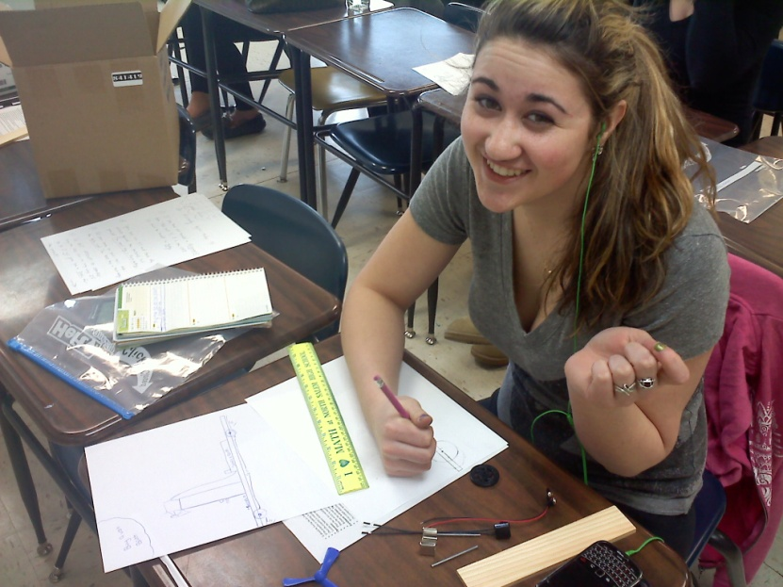
Thanks!

Slide 28
Sources
Rational Number Project
Lesh, R., Cramer, K., Doerr, H., Post, T., Zawojewski, J., (2003) Using a translation model for curriculum development and classroom instruction. In Lesh, R., Doerr, H. (Eds.) Beyond Constructivism. Models and Modeling Perspectives on Mathematics Problem Solving, Learning, and Teaching. Lawrence Erlbaum Associates, Mahwah, New Jersey.
Cramer, K., (2001) Using Models to Build Middle-Grade Students' Understanding of Functions. Mathematics Teaching in the Middle School. 6 (5), 310-318.mber Project
Davis, Robert, developer. Madison Project Independent Exploration Materials. Danbury Conn.: Math Media, 1966.

